Slide 1

(CSC 1100) ELEMENTS OF PROGRAMMING PROJECT
BY:
MUHAMMAD IBRAHIM (1627123)
K m tansir hussain (1638331)
HASAN TANVEER MAHMOOD (1725413)
MD RAISUL ISLAM (1725501)

Slide 2
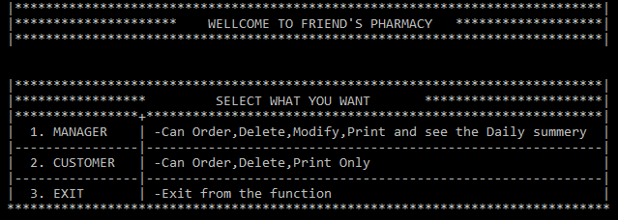
Pharmacy management system (Project title forTANVEER & group)
INTRODUCTION:
-Our Group have made project on Pharmacy Management System.
-We have select Pharmacy Name as “Friend’s Pharmacy”.
-There are two user for our system “Manager” & “Customer”.

Slide 3
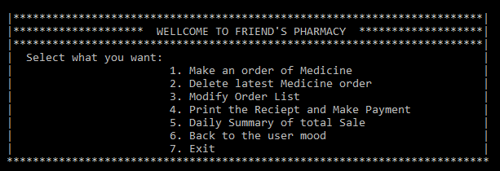
Manager:
Manager can perform actions mentioned below with valid username and password:
-Order
-Delete
-Modify
-Print & See the daily summary

Slide 4
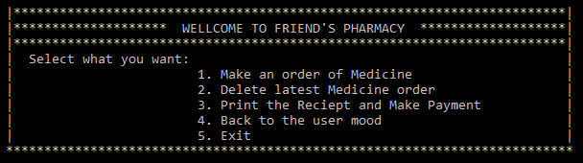
Customer:
Customer can perform actions mentioned below:
-Make an order of medicine
-Delete latest Medicine order
-Print the receipt and make payment

Slide 5
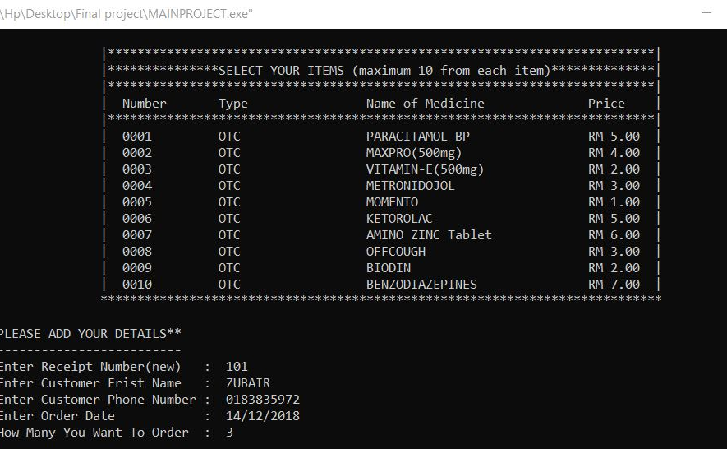
Take order page :

Slide 6
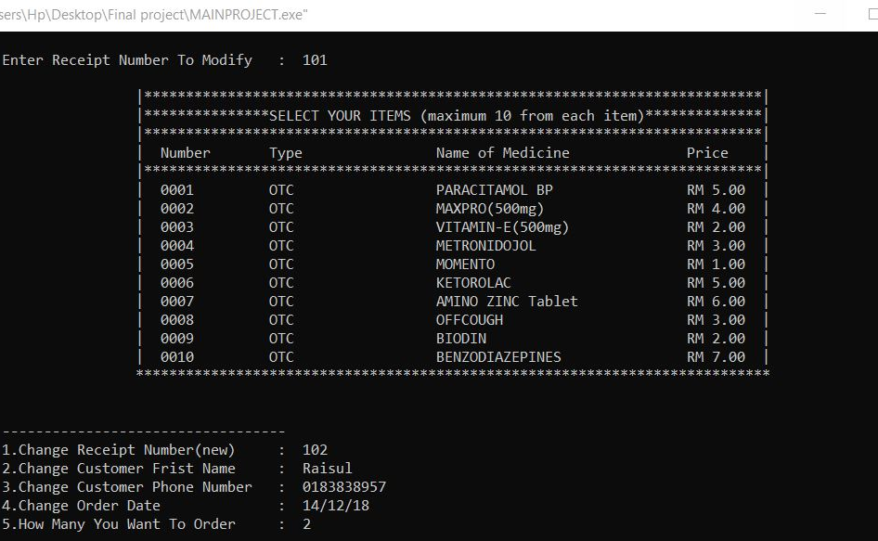
Modify interface :

Slide 7
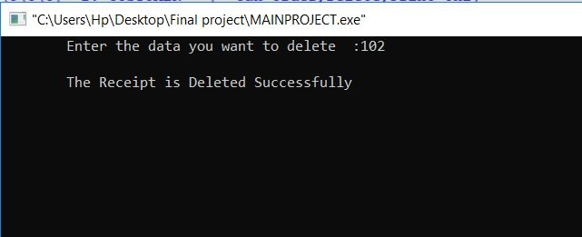
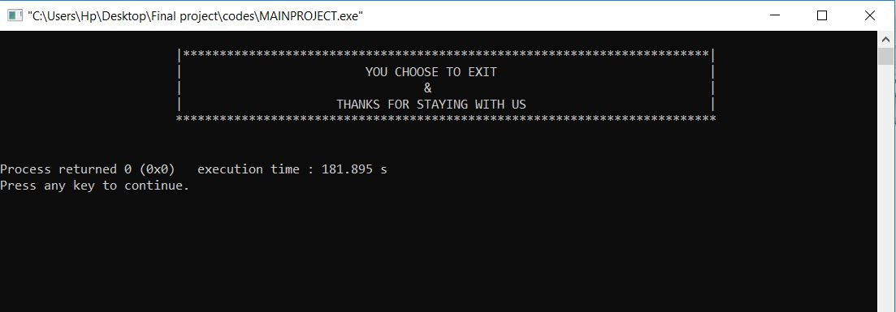
DELETE & EXIT FUNCTION PAGE :

Slide 8
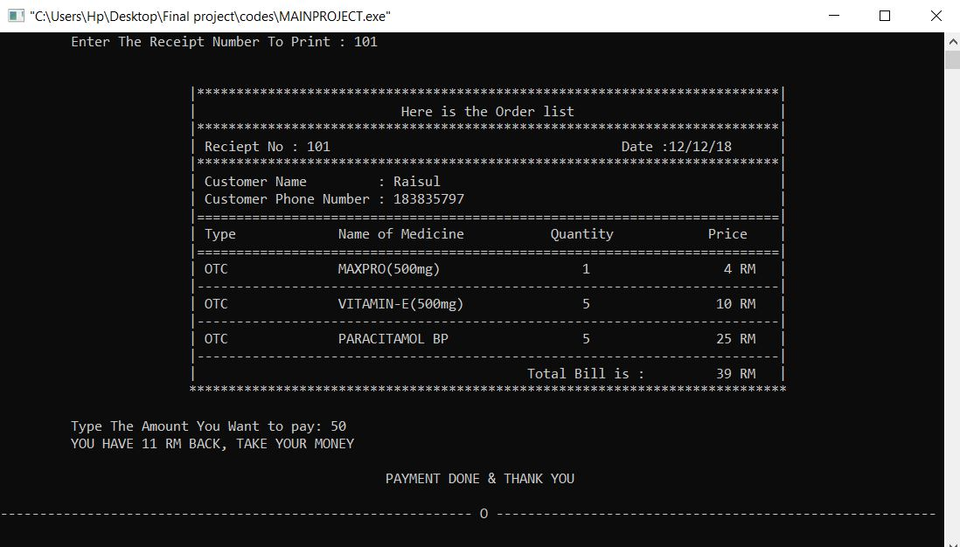
Receipt page Interface :

Slide 9
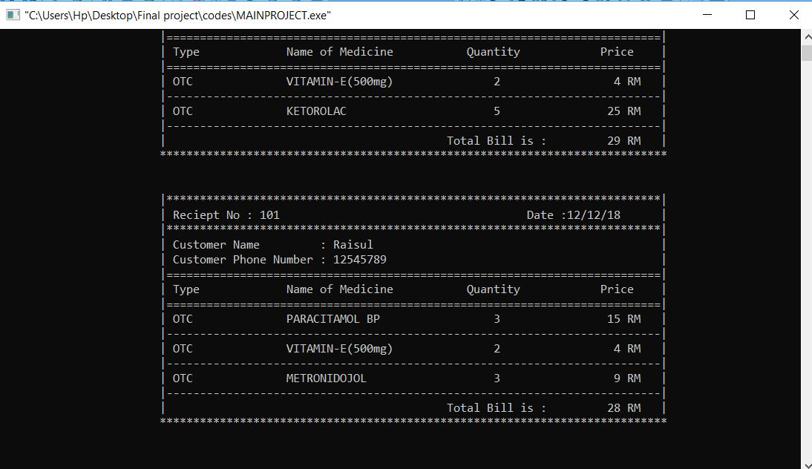
DAILY SUMMARY PAGE :

Slide 10
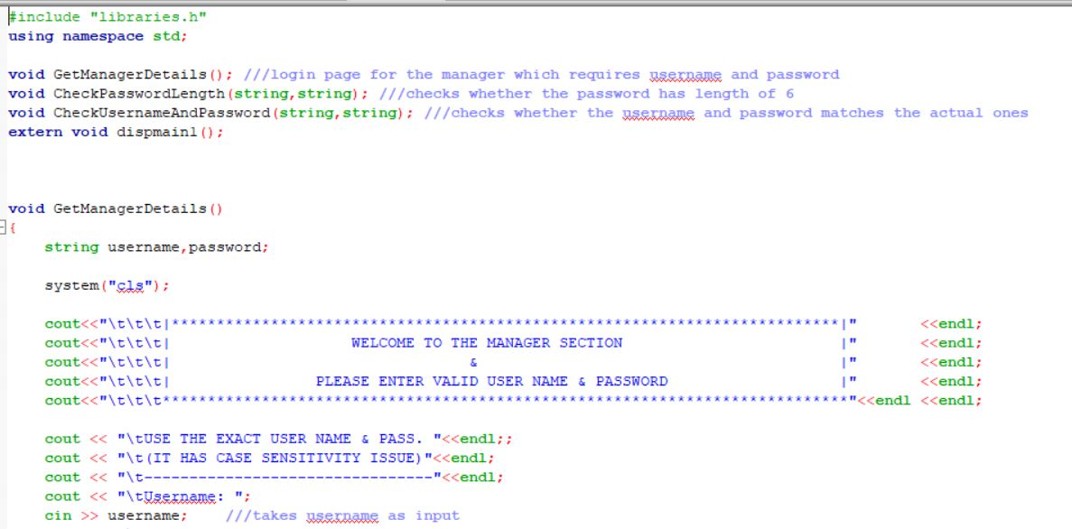
Sample coding page(function) :

Slide 11
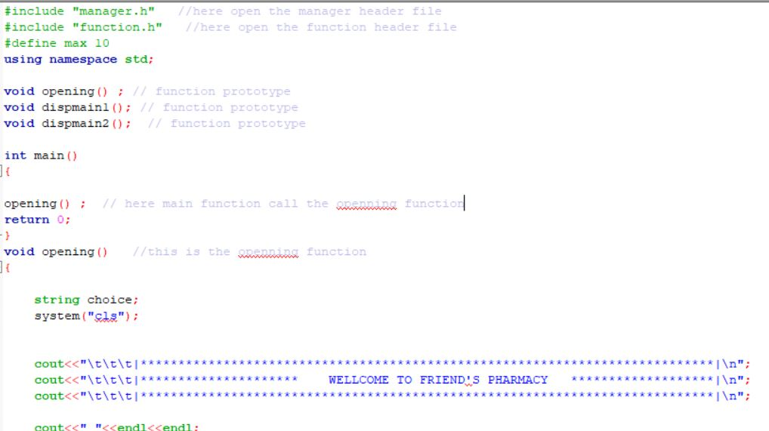
Main page interface of coding:

Slide 12
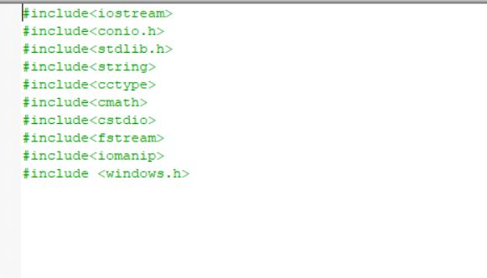
Library function code page :

Slide 13
Further you can see in our program how does it work and perform actions respectively.
Thank you.

